Slide 1



Center for Data Science and Applied Machine Learning
& Cloud Computing and Big Data (CDSAML & CCBD)
Internship, June – July, 2026
Adaptive-IPI: A Teacher-Guided Adaptive Curriculum for Lightweight Indirect Prompt Injection Detection in AI Email Assistants
Project Team
Subramani B M (PES1UG24CS473)
Sudeeksh Nayak (PES1UG24CS474)
Ahidwish Javali (PES1UG24CS037)
Project Guide
Dr. Bhargavi Mokashi
Designation: Associate Professor, Dept of CSE

Slide 2
Outline
e Project
Adaptive-IPI
01 Problem Statement
06 Datasets used
02 Abstract and Scope
07 Technologies used
03 Literature Survey
08 Results
04 Methodology / Approach
09 Conclusion and Future Work
05 Architecture
10 References

Slide 3
Adaptive IPI
Adaptive-IPI
CDSAML & CCBD
Problem Statement
Large Language Models (LLMs) are increasingly vulnerable to Indirect Prompt Injection (IPI) attacks, where malicious instructions embedded within external content manipulate the model. Existing defenses rely on large, expensive models, making real-time deployment impractical.
Context
With rapid adoption of AI assistants in email clients, enterprise systems, and autonomous agents, lightweight yet robust IPI detection has become essential for secure, scalable, and cost-effective deployment.
Project Overview & Scope
This project proposes Adaptive-IPI, a lightweight framework using an offline teacher LLM to generate targeted adversarial samples, enabling a compact student model (ModernBERT) to improve robustness with efficient inference.
Objective
Develop an efficient and deployable IPI detection system.
Improve robustness against unseen adversarial attacks.
Achieve strong detection performance without relying on large LLMs during inference.
Adopted Approach
Train a lightweight ModernBERT detector on the BIPIA dataset.
Analyze model failures to identify weak cases.
Use a teacher LLM to generate adversarial curriculum samples.
Retrain the student model with the adaptive curriculum and evaluate improvements using AUROC, F1-score, Precision, Recall, and Calibration.

Slide 4
Adaptive IPI
Adaptive-IPI
CDSAML & CCBD
Literature Survey
Paper | Methodology | Limitations / Gap | Relevance to Our Work
Can Indirect Prompt Injection Attacks Be Detected and Removed? (ACL 2025) | Lightweight DeBERTa/Qwen2 classifiers with detection and removal pipeline. | Uses standard supervised classification; suffers from over-defense and lacks reasoning-guided learning. | Closest prior work. Motivates lightweight IPI detection. Our work replaces standard supervision with reasoning-guided distillation.
PIGuard (ACL 2025) | DeBERTa-based prompt guard using MOF training to reduce over-defense. | Conventional classification without reasoning or knowledge distillation. | Strong lightweight baseline. Our work investigates whether reasoning supervision improves detection.
Performance-Guided LLM Knowledge Distillation for Efficient Text Classification at Scale (EMNLP 2024) | Uses a teacher LLM to generate hard examples for iterative curriculum learning and retrains a lightweight student model. | Designed for general text classification and does not address indirect prompt injection attacks or LLM security. | We extend PGKD by applying adaptive curriculum learning to lightweight indirect prompt injection detection using ModernBERT.
Attention is All You Need to Defend Against INdirect Prompt Injection Attacks in LLMS (NDSS 2026) | Attention-based token-level detection and sanitization using internal LLM attention. | Requires access to internal model representations. | Demonstrates attention-based IPI defense; our approach remains fully model-agnostic.
MELON (ICML 2025) | Detects attacks through masked re-execution and comparison of agent tool calls. | Limited to tool-calling agents and doubles inference cost. | Complements our work by protecting execution, whereas we perform content-level detection before execution.
Defending Against Indirect Prompt Injection By Instruction Detection (EMNLP Findings 2025) | Uses hidden states and gradients from intermediate LLM layers for instruction detection. | Requires internal representations and higher inference overhead. | Shows behavioral features are effective, while our method aims for lightweight CPU-friendly deployment.
Take Off Your Disguise: Detecting Prompt-Based Jailbreak Attacks in LLMS (IEEE TCSS 2026) | Uses LLM reasoning and prompt reconstruction to uncover disguised malicious intent. | Focuses on disguised jailbreaks and requires online LLM reasoning. | Motivates the use of teacher reasoning, which we distill into a lightweight ModernBERT model.

Slide 5
Adaptive IPI
Adaptive-IPI
CDSAML & CCBD
Methodology
PHASE 01
Teacher-Guided Distillation
A frozen, offline Qwen teacher supervises the ModernBERT-Base student using soft probability distributions and binary labels over the BIPIA Email QA training set, combining supervised classification with soft-label alignment.
PHASE 02
Adaptive Curriculum
After the initial student converges, validation failures are analyzed and supplied to the frozen teacher, which generates targeted hard-negative examples for a single adaptive refinement stage.
PHASE 03
Distribution Expansion
Curated enterprise Email QA-style communications from the Enron corpus (Enron250 / Enron500 / Enron1000) are added to the benign training distribution to reduce false positives on unseen enterprise communications.
PHASE 04
Inference Pipeline
Only the lightweight ModernBERT-Base student is used at deployment; retrieved emails are tokenized and classified as Benign or Indirect Prompt Injection before reaching the downstream Email QA LLM.

Slide 6
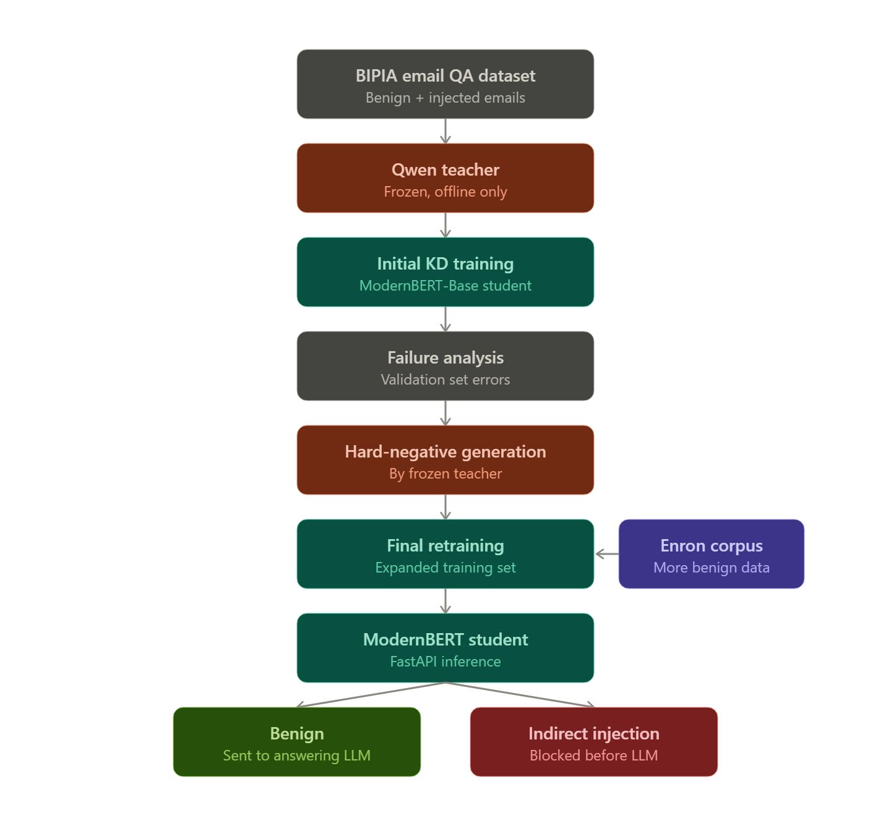
Adaptive IPI
Adaptive-IPI
CDSAML & CCBD
Architecture

Slide 7
Adaptive IPI
Adaptive-IPI
CDSAML & CCBD
Datasets used
DATASET 01
BIPIA Email QA Benchmark
Official train, validation, and held-out test partitions containing benign enterprise emails together with indirect prompt injection attacks designed for Email QA systems.
DATASET 02
Benign Distribution (Enron)
Curated enterprise Email QA-style communications extracted from the Enron corpus, with controlled augmentation sets of 250, 500, and 1000 benign emails (Enron250 / Enron500 / Enron1000) for ablation experiments.
DATASET 03
Out-of-Distribution Sets
A disjoint held-out Enron subset (duplicates and near-duplicates removed) and exploratory handcrafted benign prompts, used to evaluate robustness beyond the benchmark distribution.

Slide 8
Adaptive-IPI
CDSAML & CCBD
Technologies used
TECHNOLOGIES 01
Models
Qwen: Frozen teacher used for offline annotation and hard-negative generation.
ModernBERT-Base: Lightweight student model deployed for inference.
TECHNOLOGIES 02
Frameworks & Hardware
Core Stack: Built using Python, PyTorch, and Hugging Face Transformers.
Hardware: Training performed on Apple Silicon using the Metal Performance Shaders (MPS) backend.
TECHNOLOGIES 03
Deployment
Pipeline: FastAPI-based serving pipeline.
Performance: Tailored for real-time, low-latency prompt injection filtering.

Slide 9
Adaptive-IPI
CDSAML & CCBD
Results
Performance
BIPIA Email QA Benchmark (Held-out Test Set)
Insights
Key Findings
Adaptive Curriculum: Teacher-guided hard-negative refinement improved the lightweight student's ability to distinguish indirect prompt injection attacks through targeted failure-driven supervision.
Benign Distribution Expansion: Adding 1,000 curated Enron enterprise emails reduced the held-out Enterprise False Positive Rate from 98.81% to 0.00% while maintaining strong benchmark performance.
Reproducibility: Multi-seed evaluation (Seeds 42–44) produced consistent results with a mean F1-score of 97.85% and 0.00% Enterprise OOD False Positive Rate across all evaluated seeds.
ACCURACY
96.54%
PRECISION
99.57%
RECALL
96.81%
F1-SCORE
98.17%
AUROC / AUPRC
98.01% / 99.91%
ENTERPRISE OOD FPR
0.00%

Slide 10
Adaptive-IPI
CDSAML & CCBD
Conclusion and Future Work
Conclusion
Key Takeaways
Adaptive-IPI: Pairs teacher-guided knowledge distillation with a single adaptive hard-negative refinement stage, letting a frozen teacher target the compact ModernBERT-Base student’s own failure modes without adding inference-time cost.
Distribution Expansion: Curated enterprise Email QA communications considerably improve robustness to unseen enterprise communications while preserving strong benchmark performance.
Future Work
Next Steps & Research
Benchmarks: Evaluate the framework on additional Email QA benchmarks and enterprise communication corpora.
Calibration: Investigate confidence calibration techniques such as post-hoc temperature scaling.
Refinement: Explore multiple adaptive refinement iterations while preserving lightweight deployment.
Defense Integration: Study integration with complementary defenses (intent reconstruction, retrieval verification).
Extension: Extend the methodology to other retrieval-based LLM applications beyond Email QA.

Slide 11
Adaptive-IPI
CDSAML & CCBD
References
[1] “Can Indirect Prompt Injection Attacks Be Detected and Removed?,” in Proc. ACL, 2025.
[2] “PIGuard,” in Proc. ACL, 2025.
[3] “Performance-Guided LLM Knowledge Distillation for Efficient Text Classification at Scale,” in Proc. EMNLP, 2024.
[4] “Attention is All You Need to Defend Against Indirect Prompt Injection Attacks in LLMs,” in Proc. NDSS, 2026.
[5] “MELON,” in Proc. ICML, 2025.
[6] “Defending Against Indirect Prompt Injection by Instruction Detection,” in Findings of EMNLP, 2025.
[7] “Take Off Your Disguise: Detecting Prompt-Based Jailbreak Attacks in LLMs,” IEEE Trans. Comput. Soc. Syst. (TCSS), 2026.

Slide 12
THANK YOU
Adaptive-IPI
CDSAML & CCBD

